Slide 1
Lao Conservation Trust for Wildlife
The role of Wildlife Rescue Centers in One Health
Melody Bomon, DVM
melody@lctwildlife.org

Slide 2
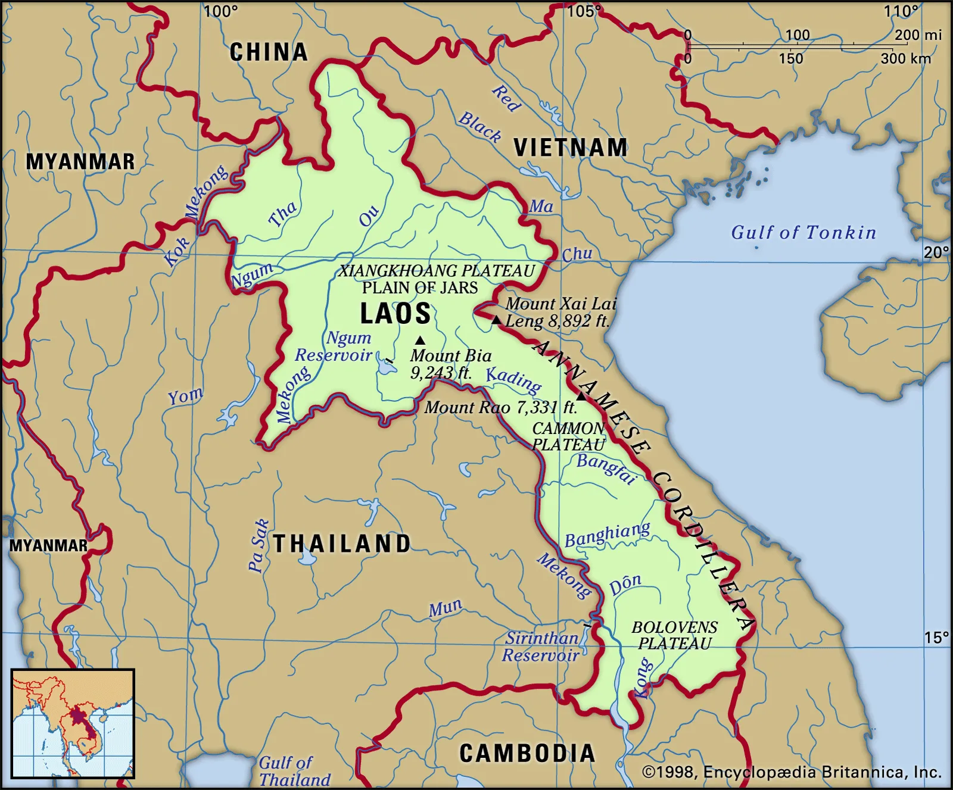

Slide 3
What do we do?
Wildlife crime hotline
Wildlife rescue
Wildlife rehabilitation
Wildlife release
Wildlife sanctuary
Environmental education
Breed & release of endangered species

Slide 4
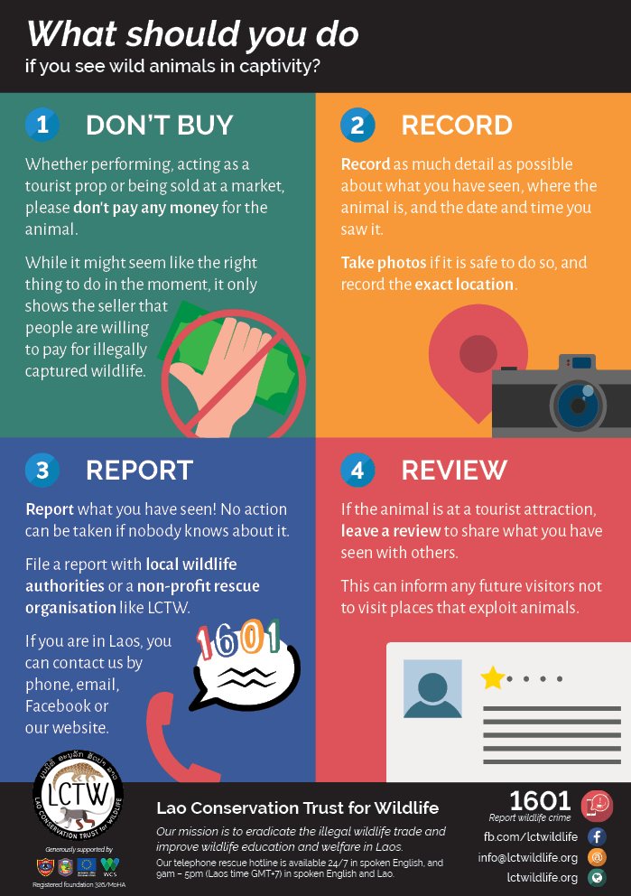
Wildlife crime hotline

Slide 5
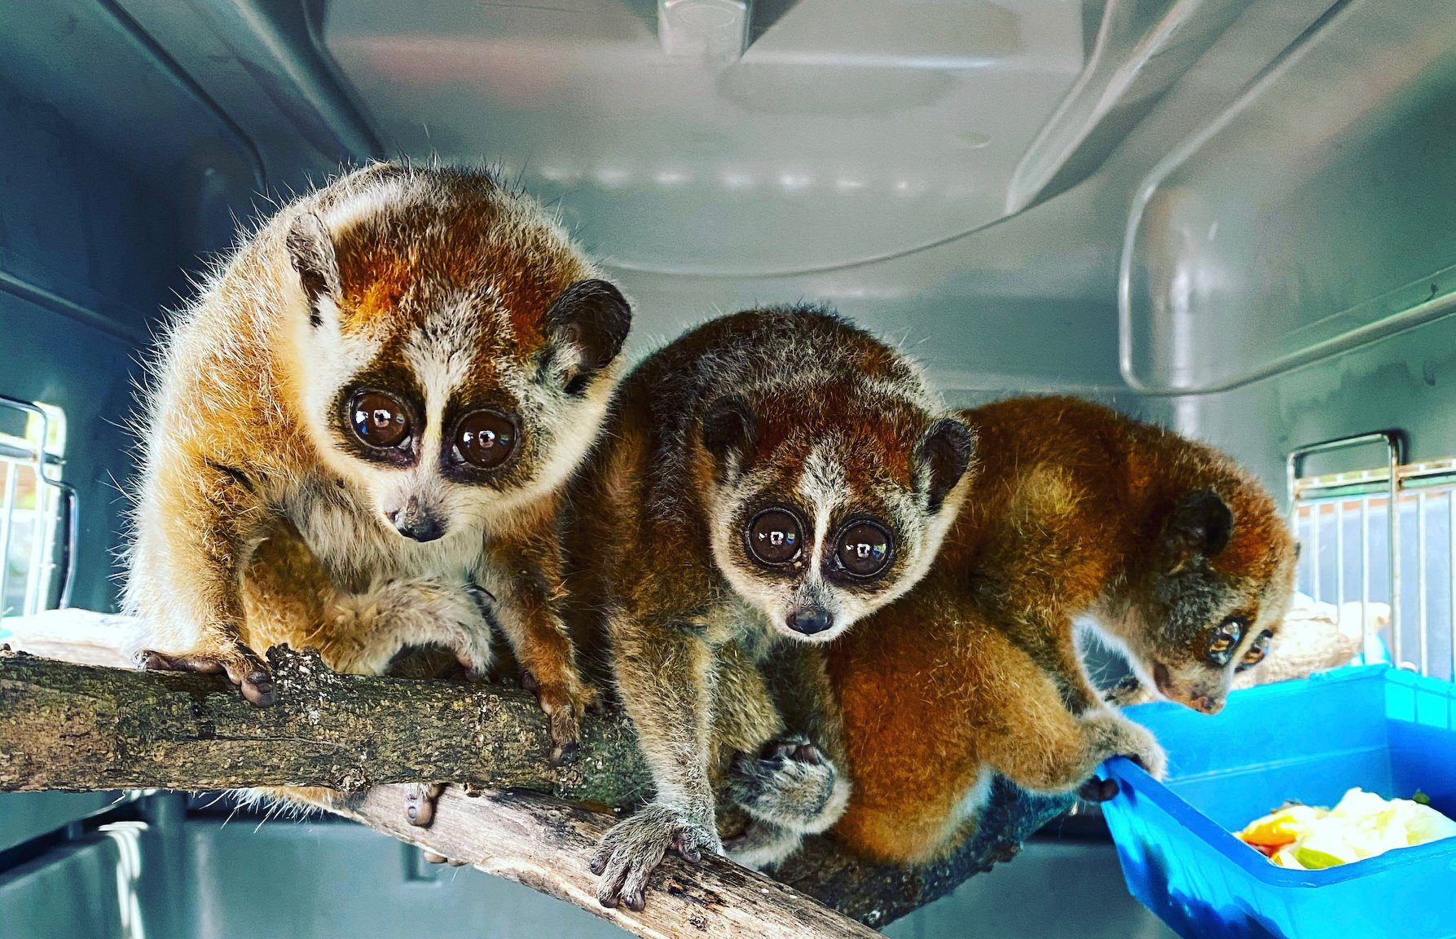
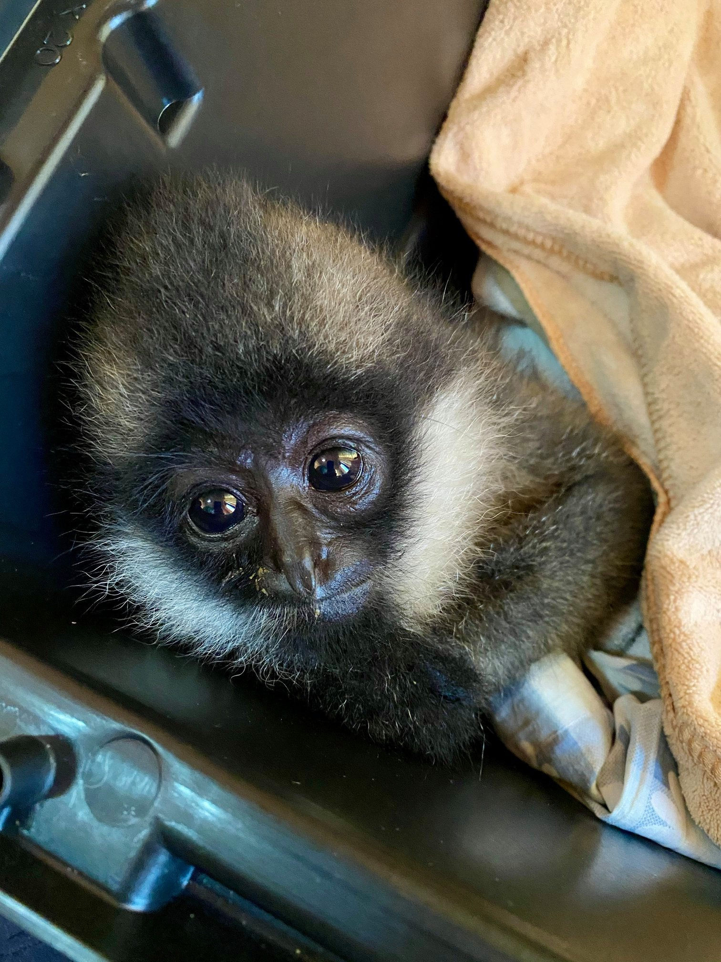
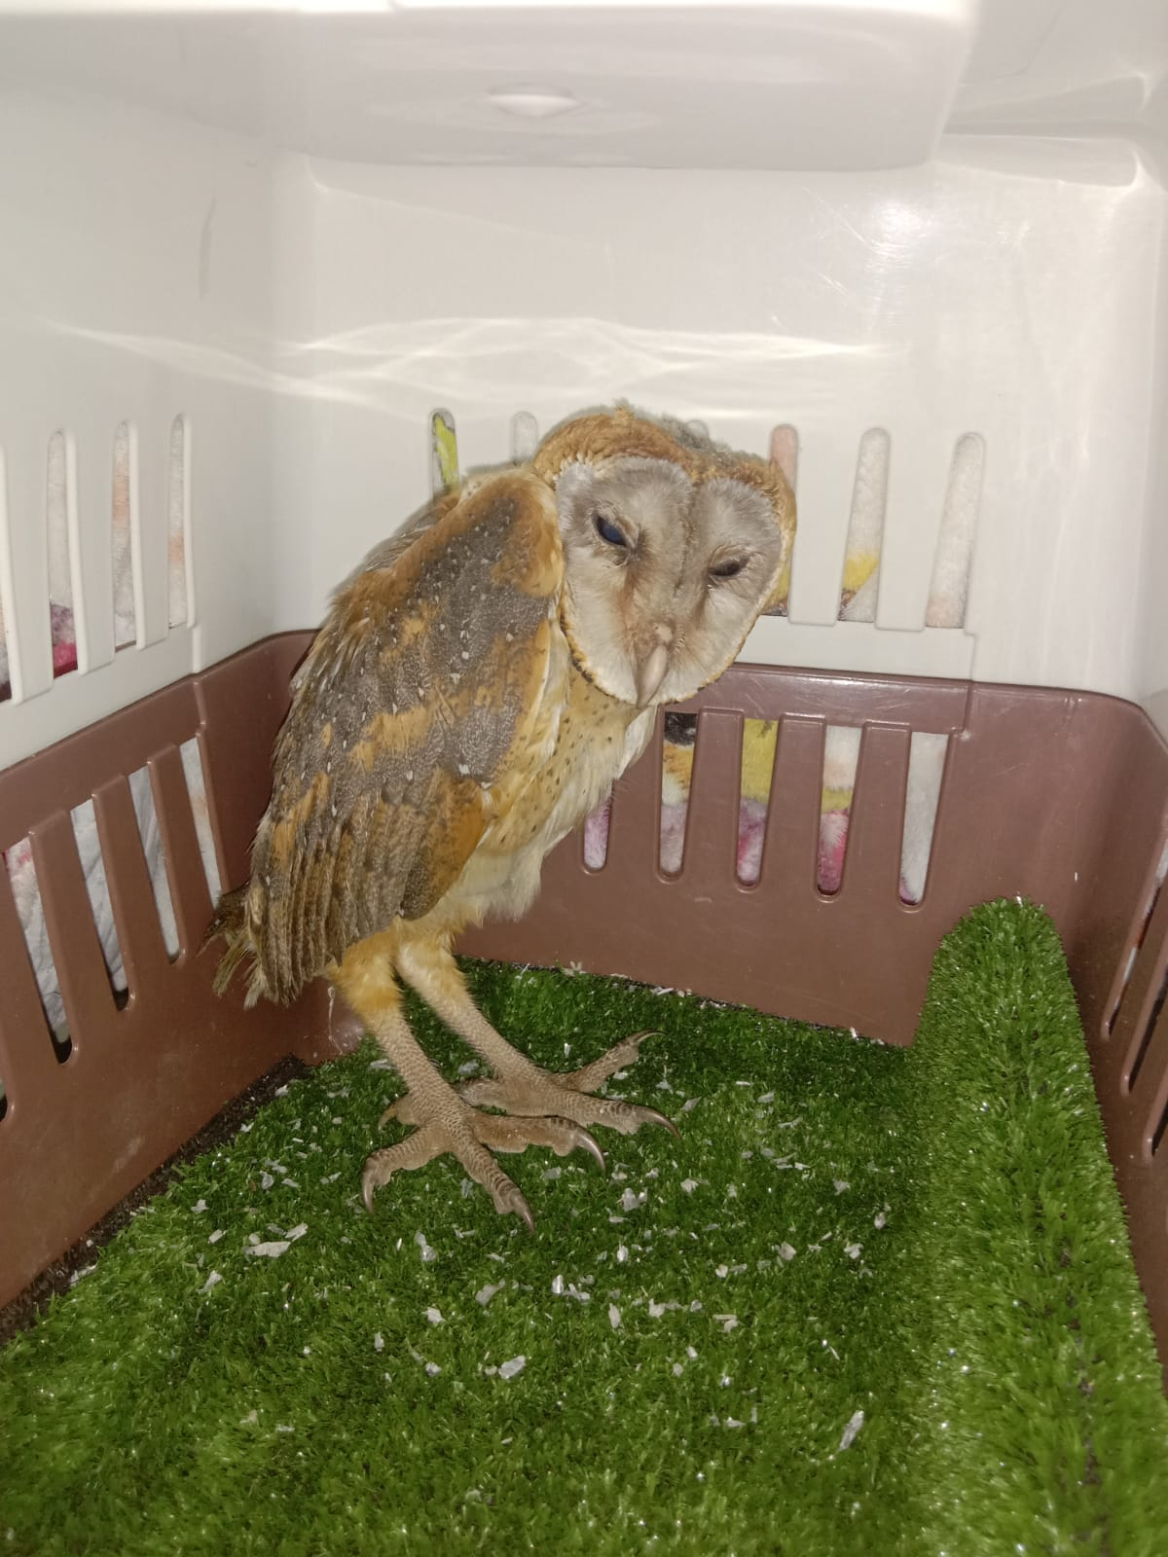
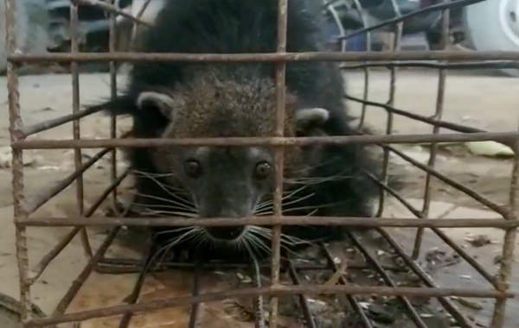
Wildlife
rescue

Slide 6
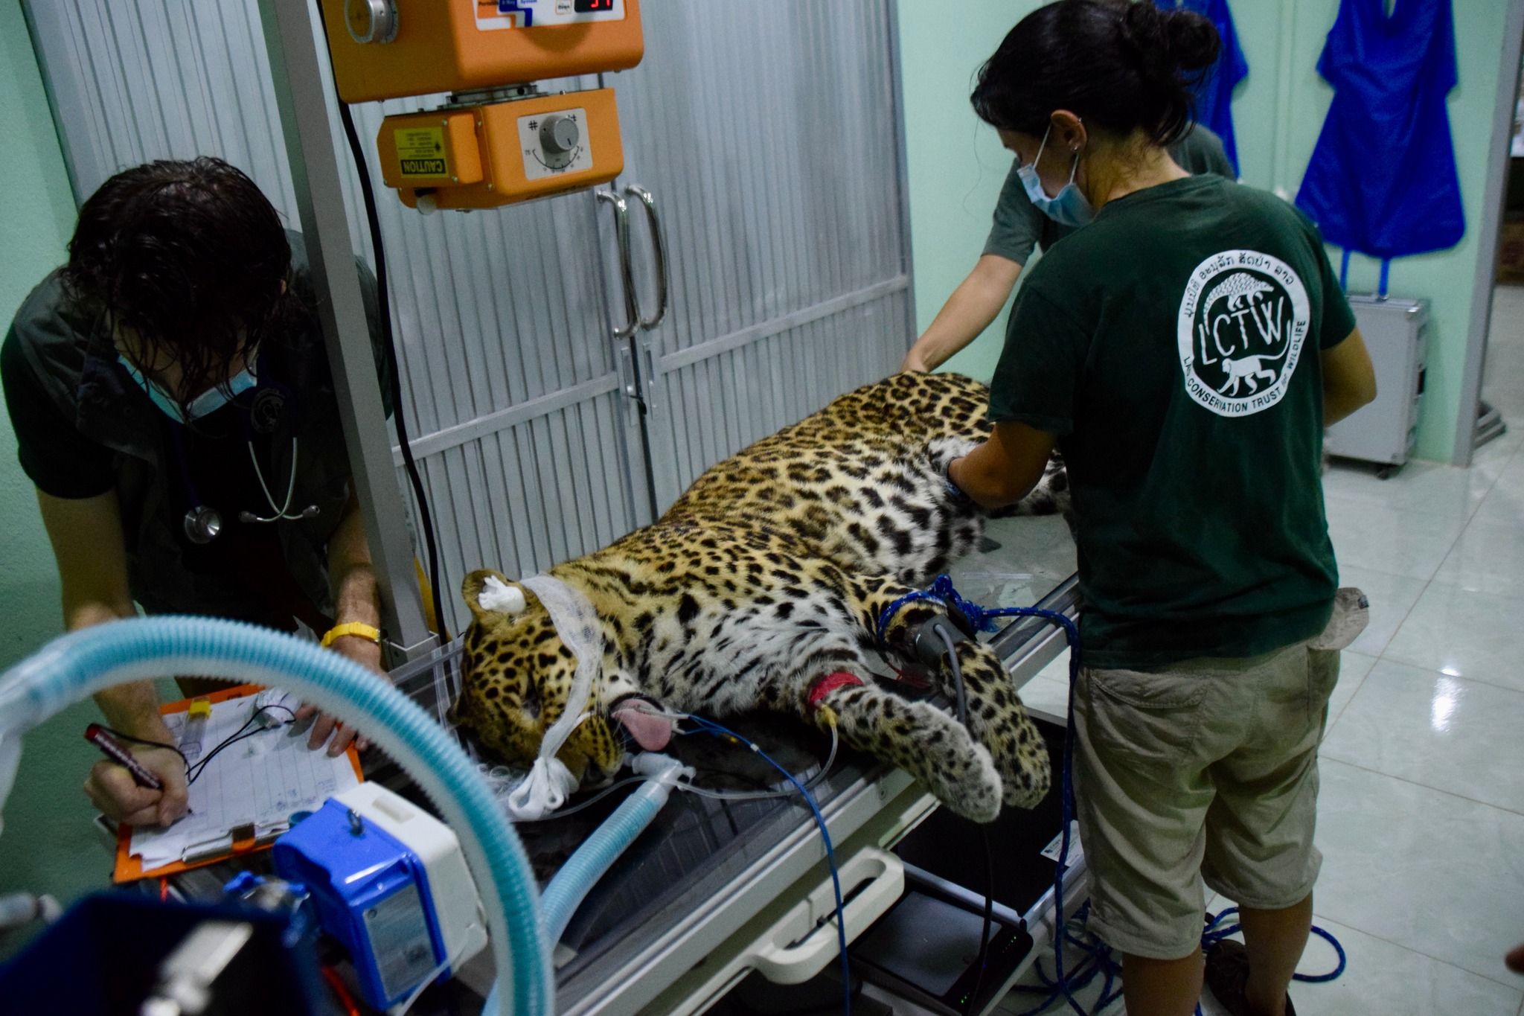
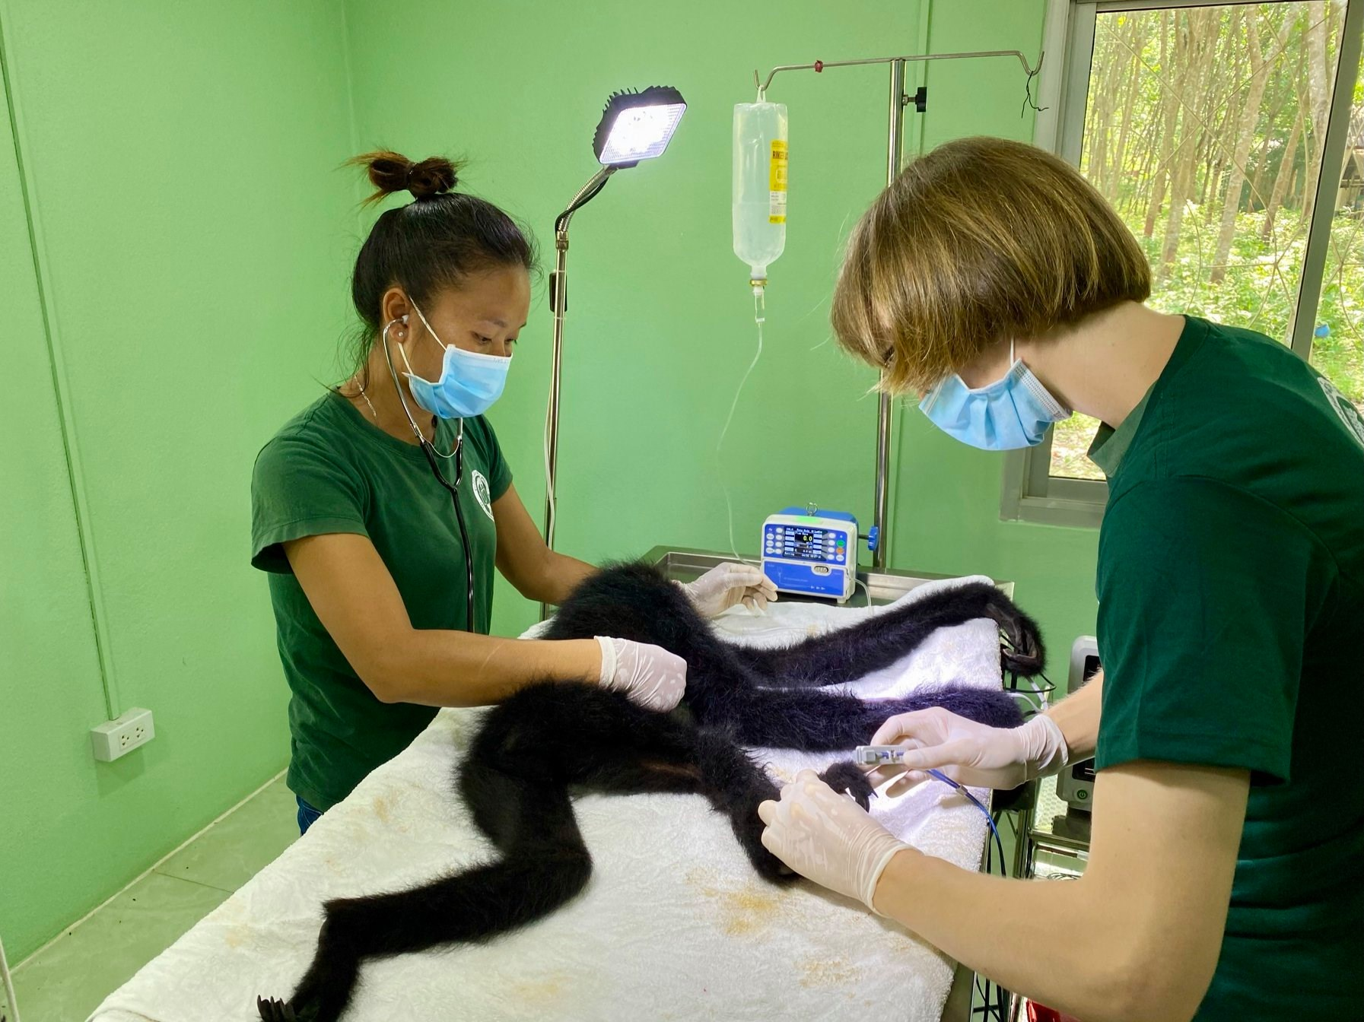
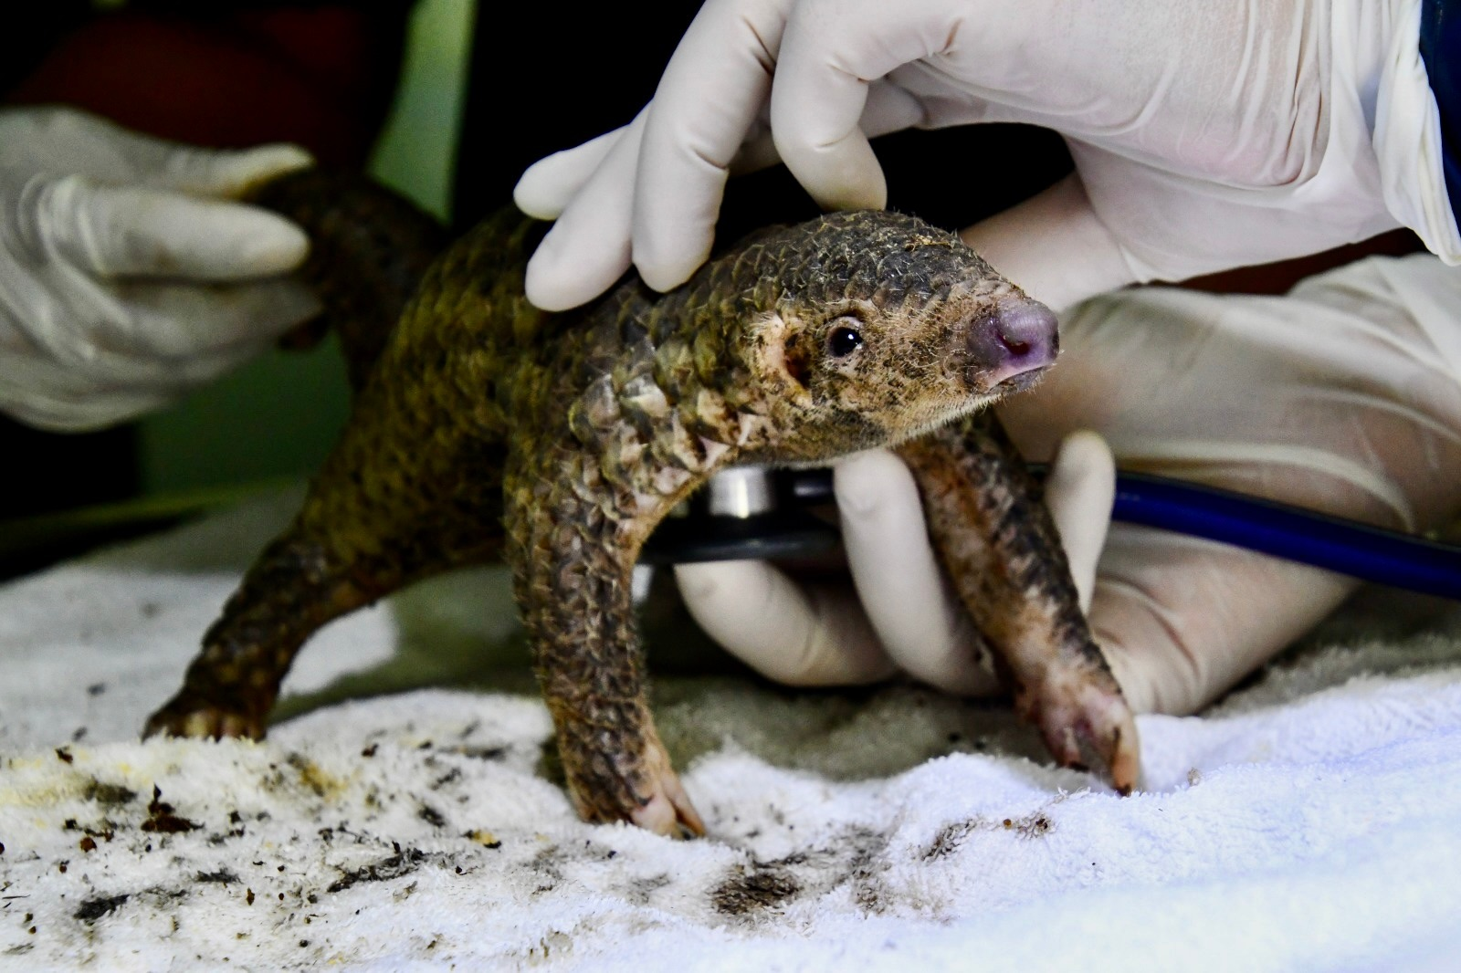
Wildlife rehabilitation

Slide 7
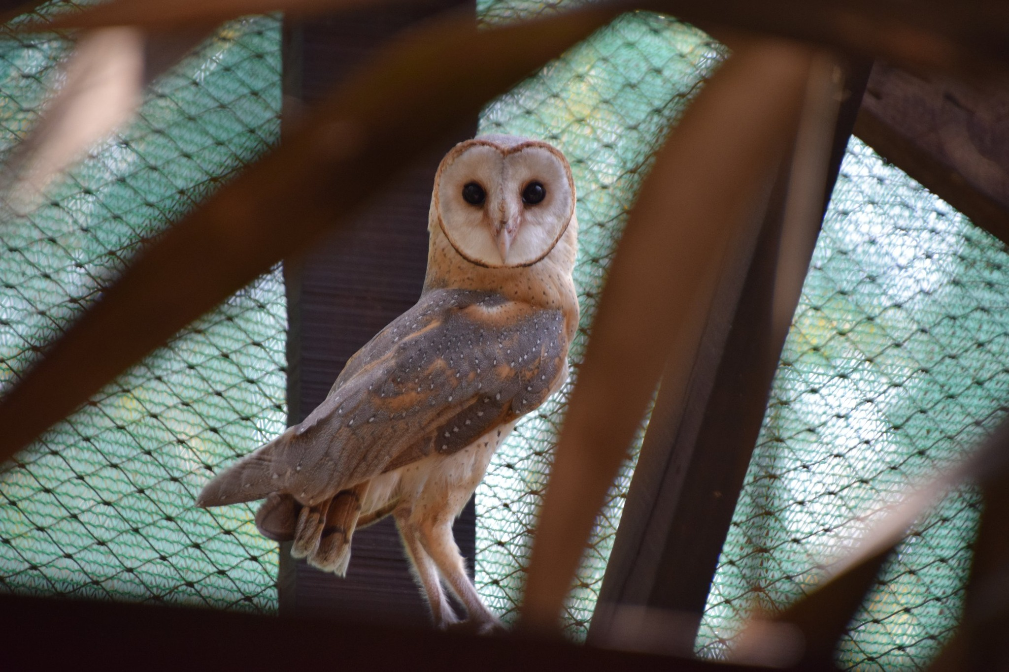

Slide 8
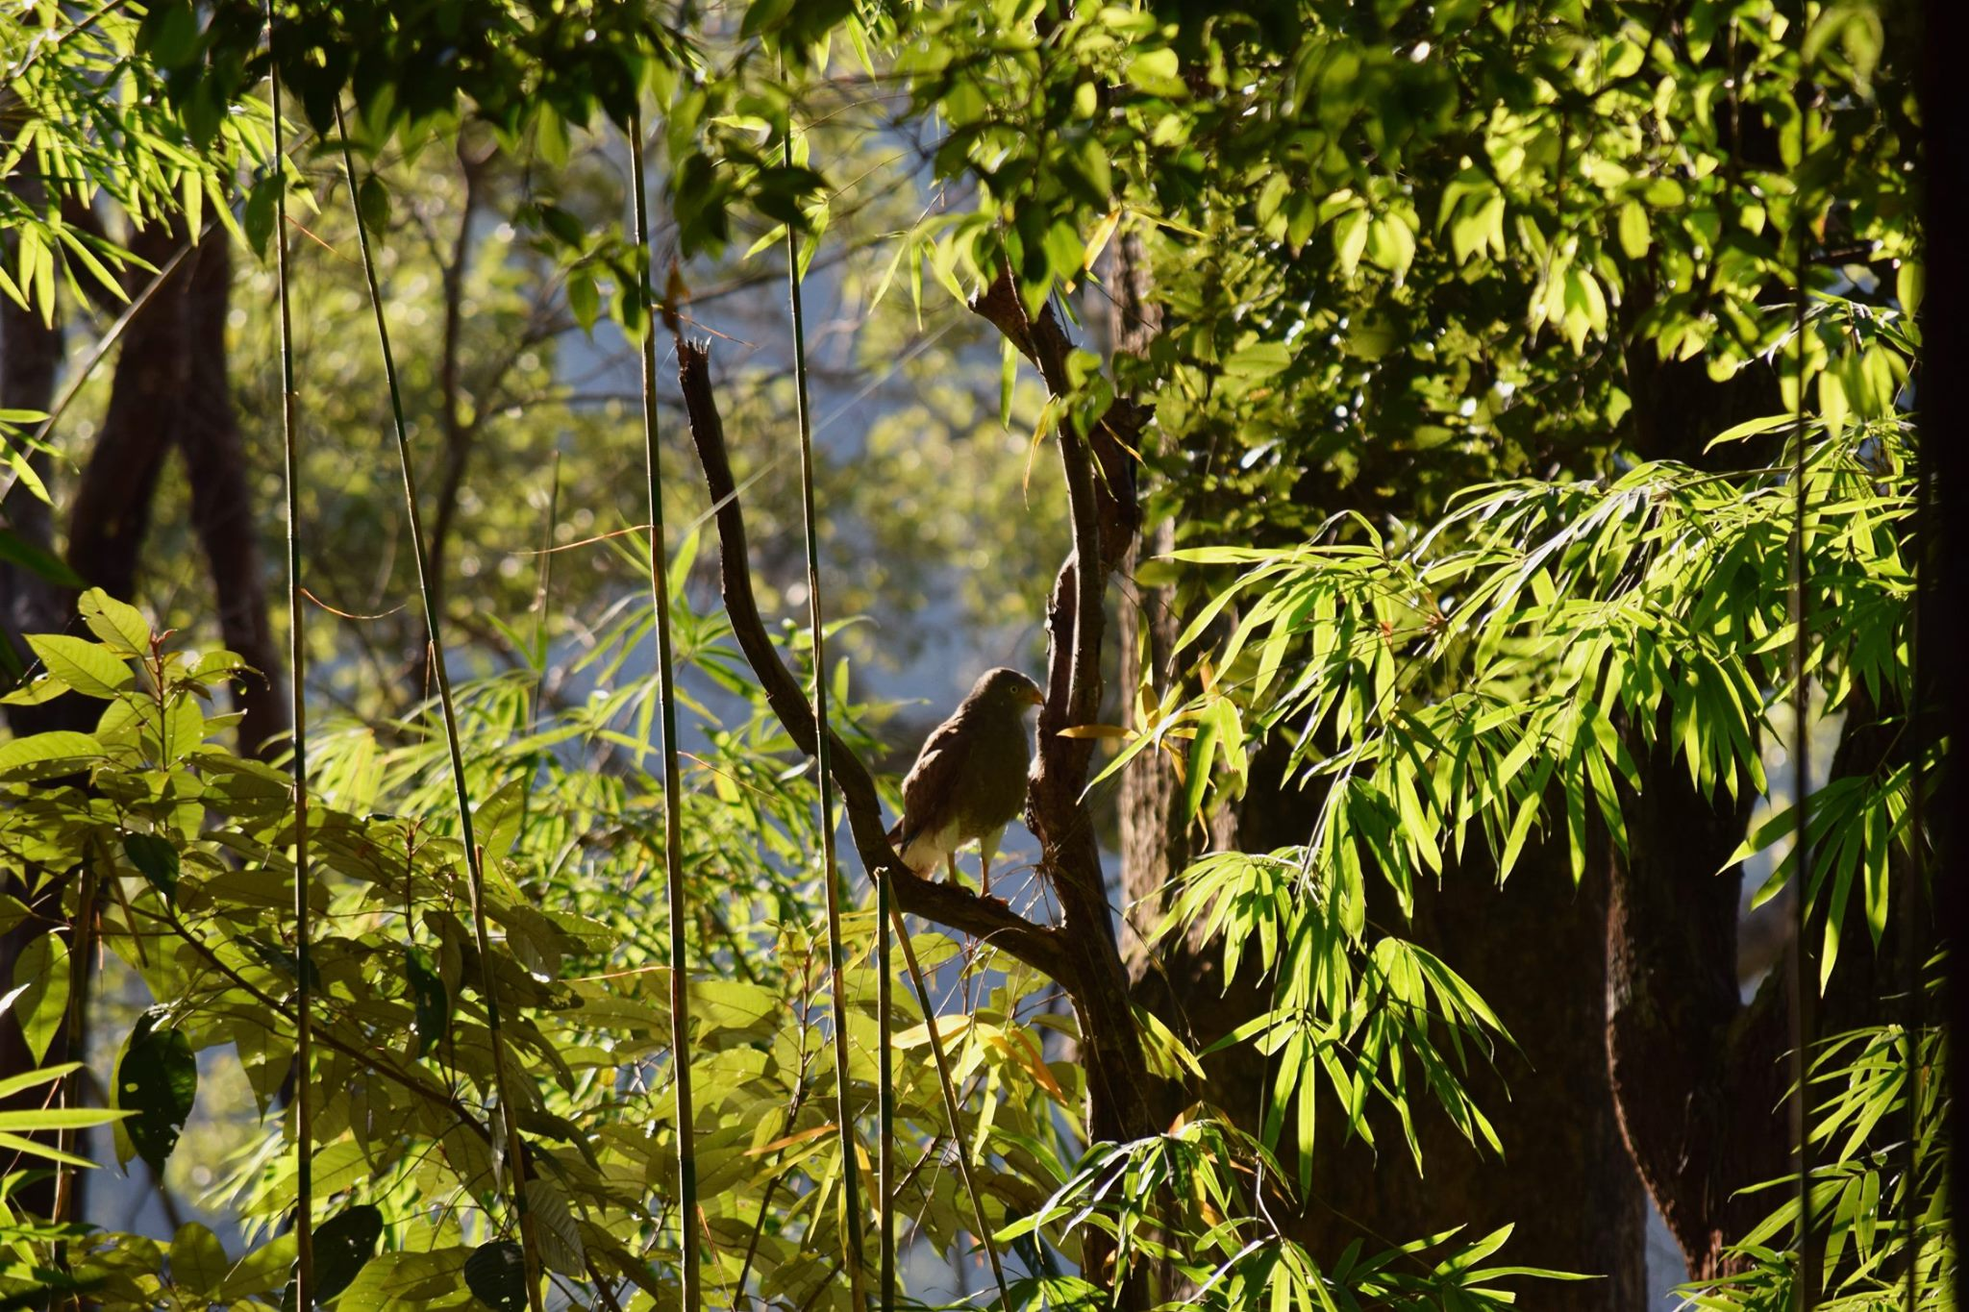
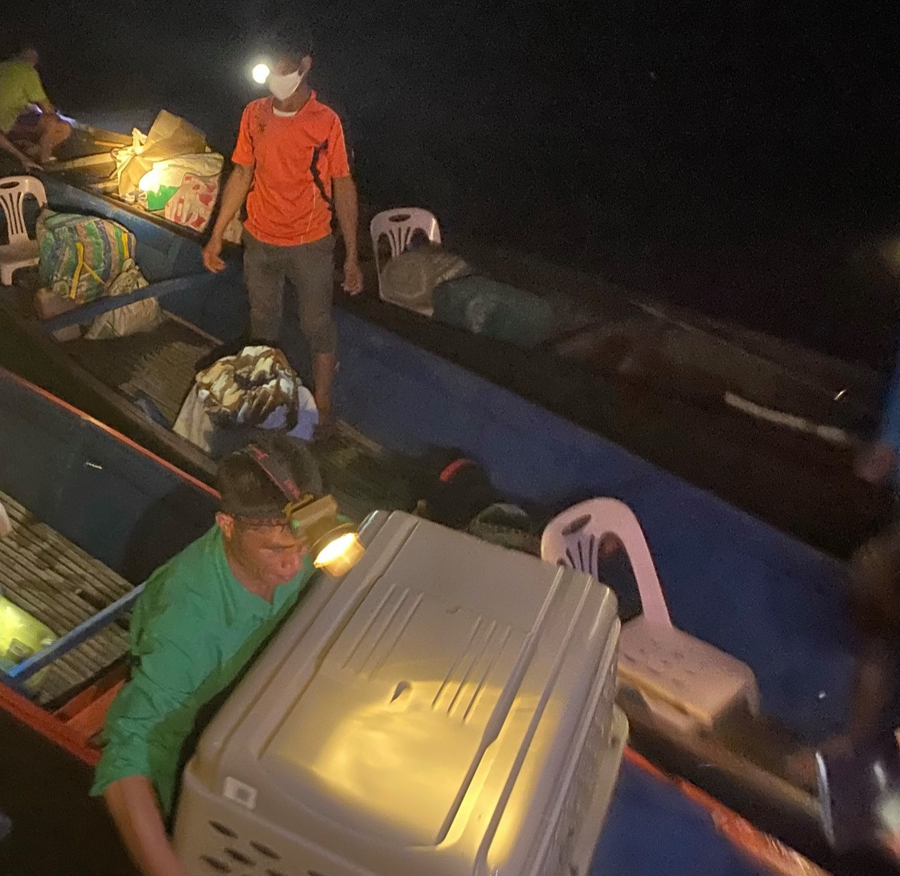
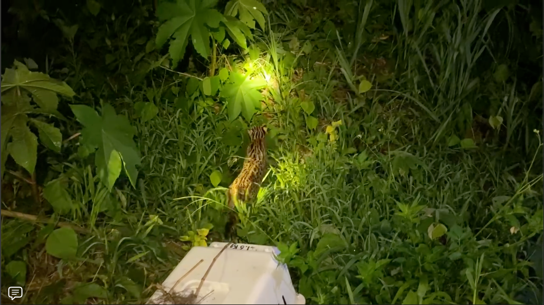
Wildlife release

Slide 9
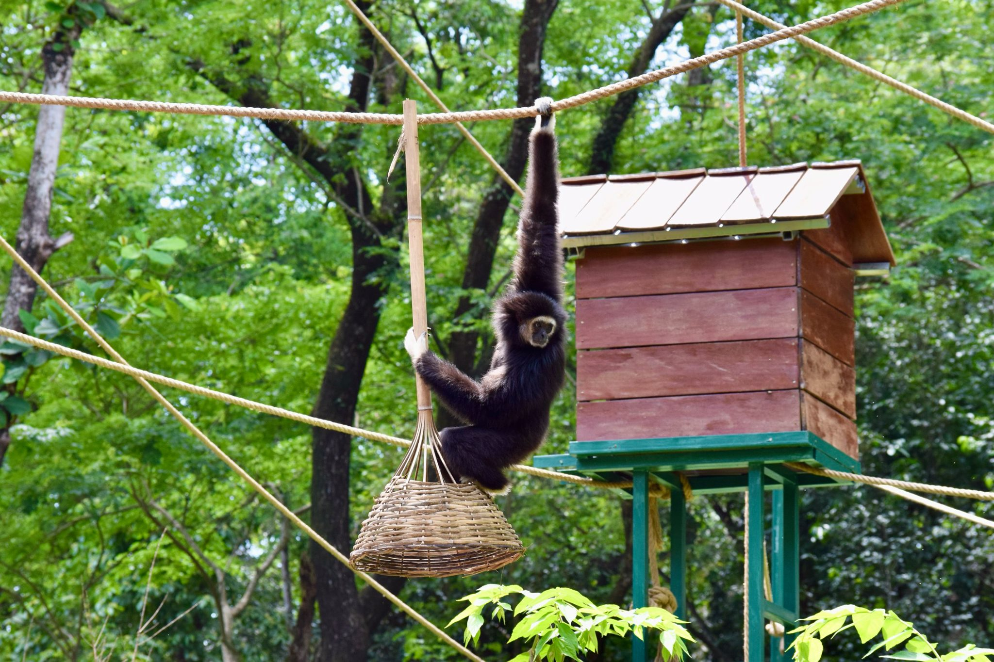
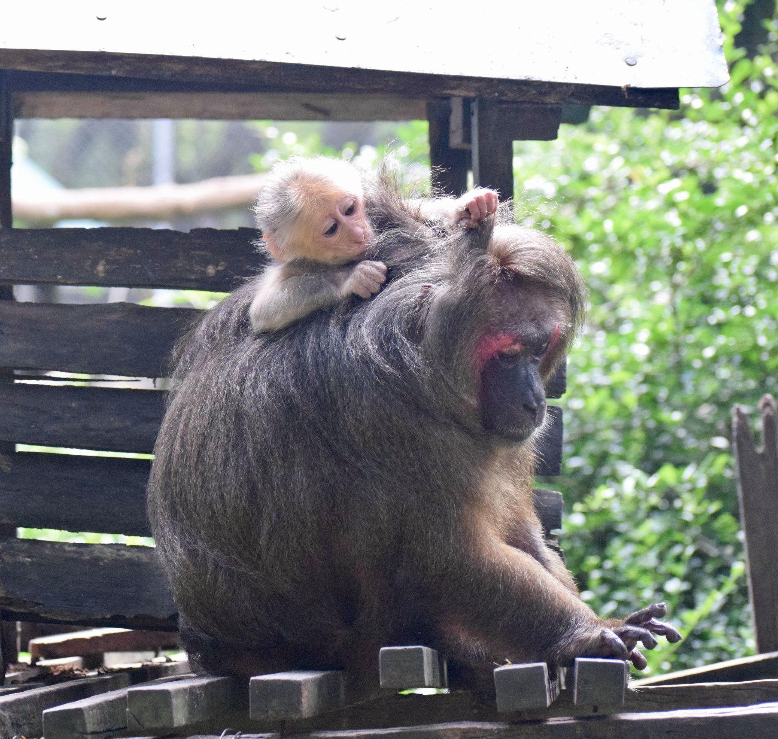
Wildlife
sanctuary

Slide 10
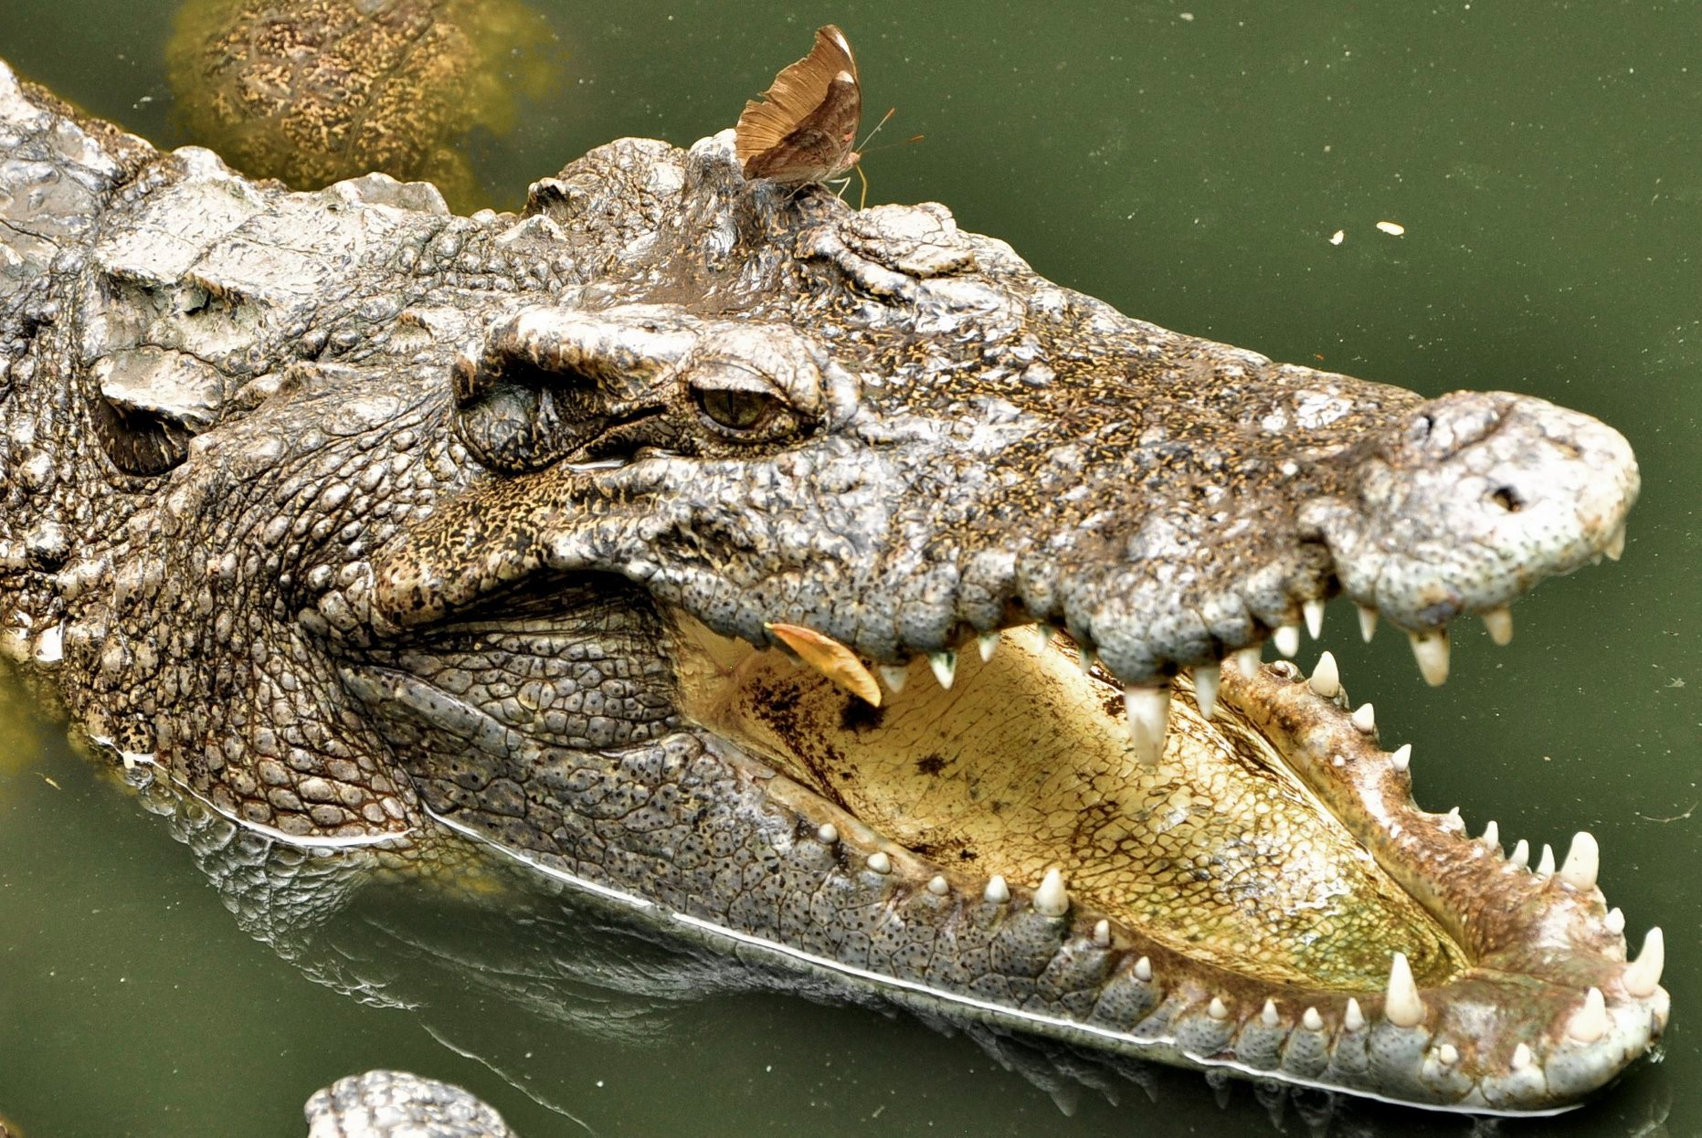
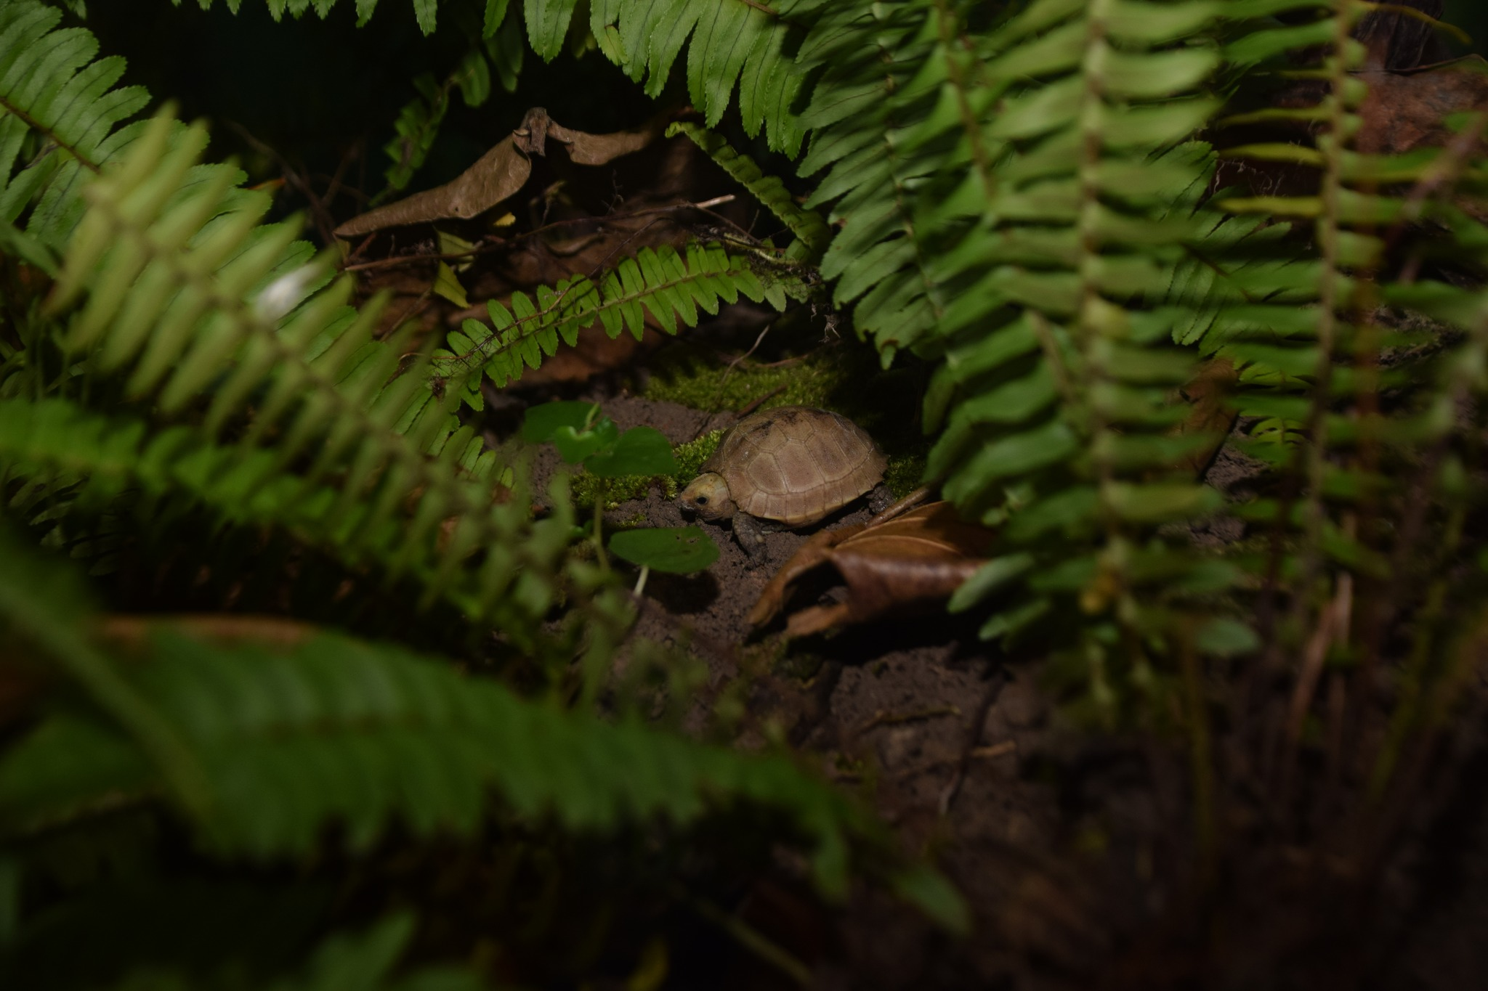
Breed & release programmes

Slide 11
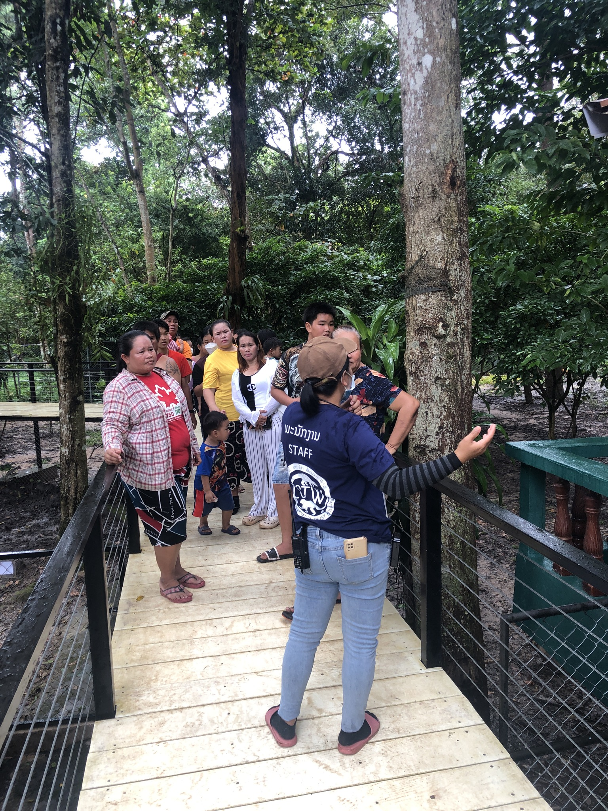
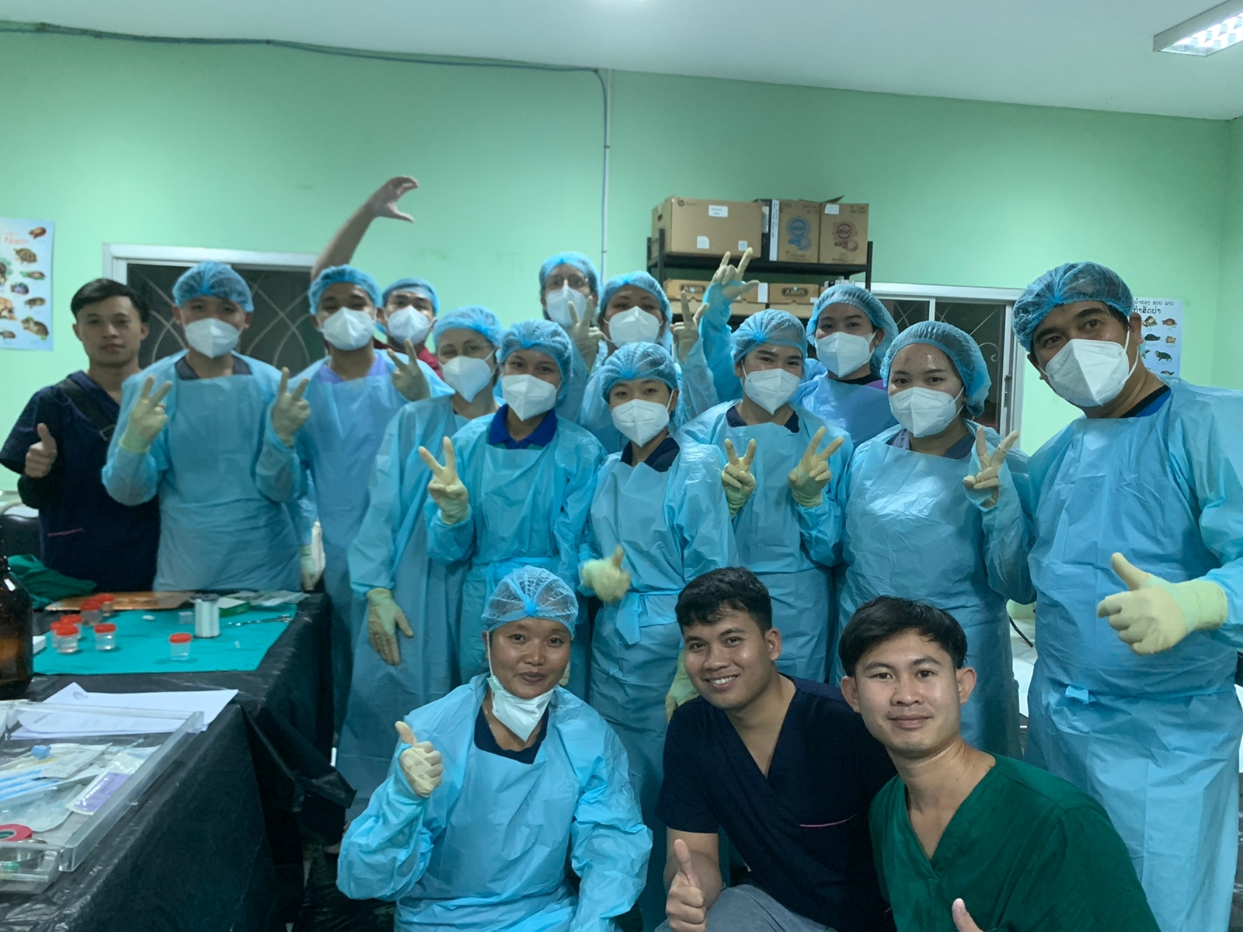
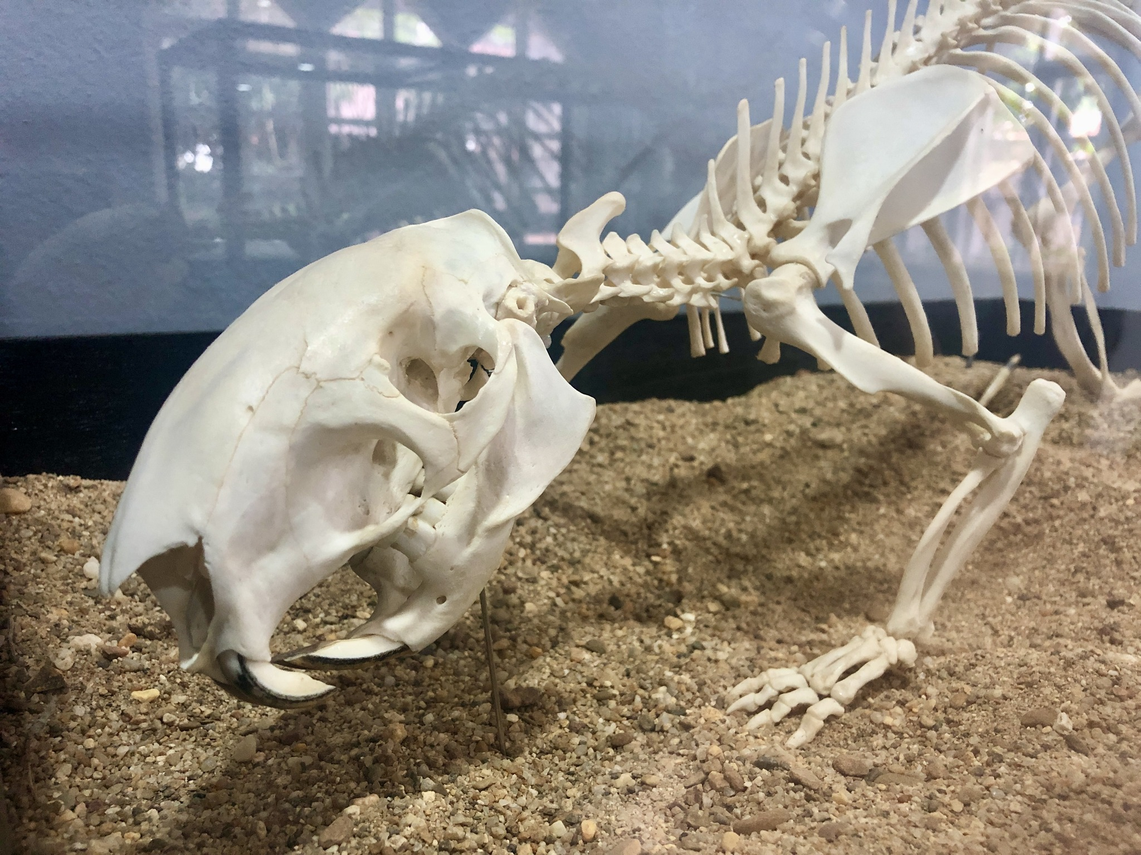
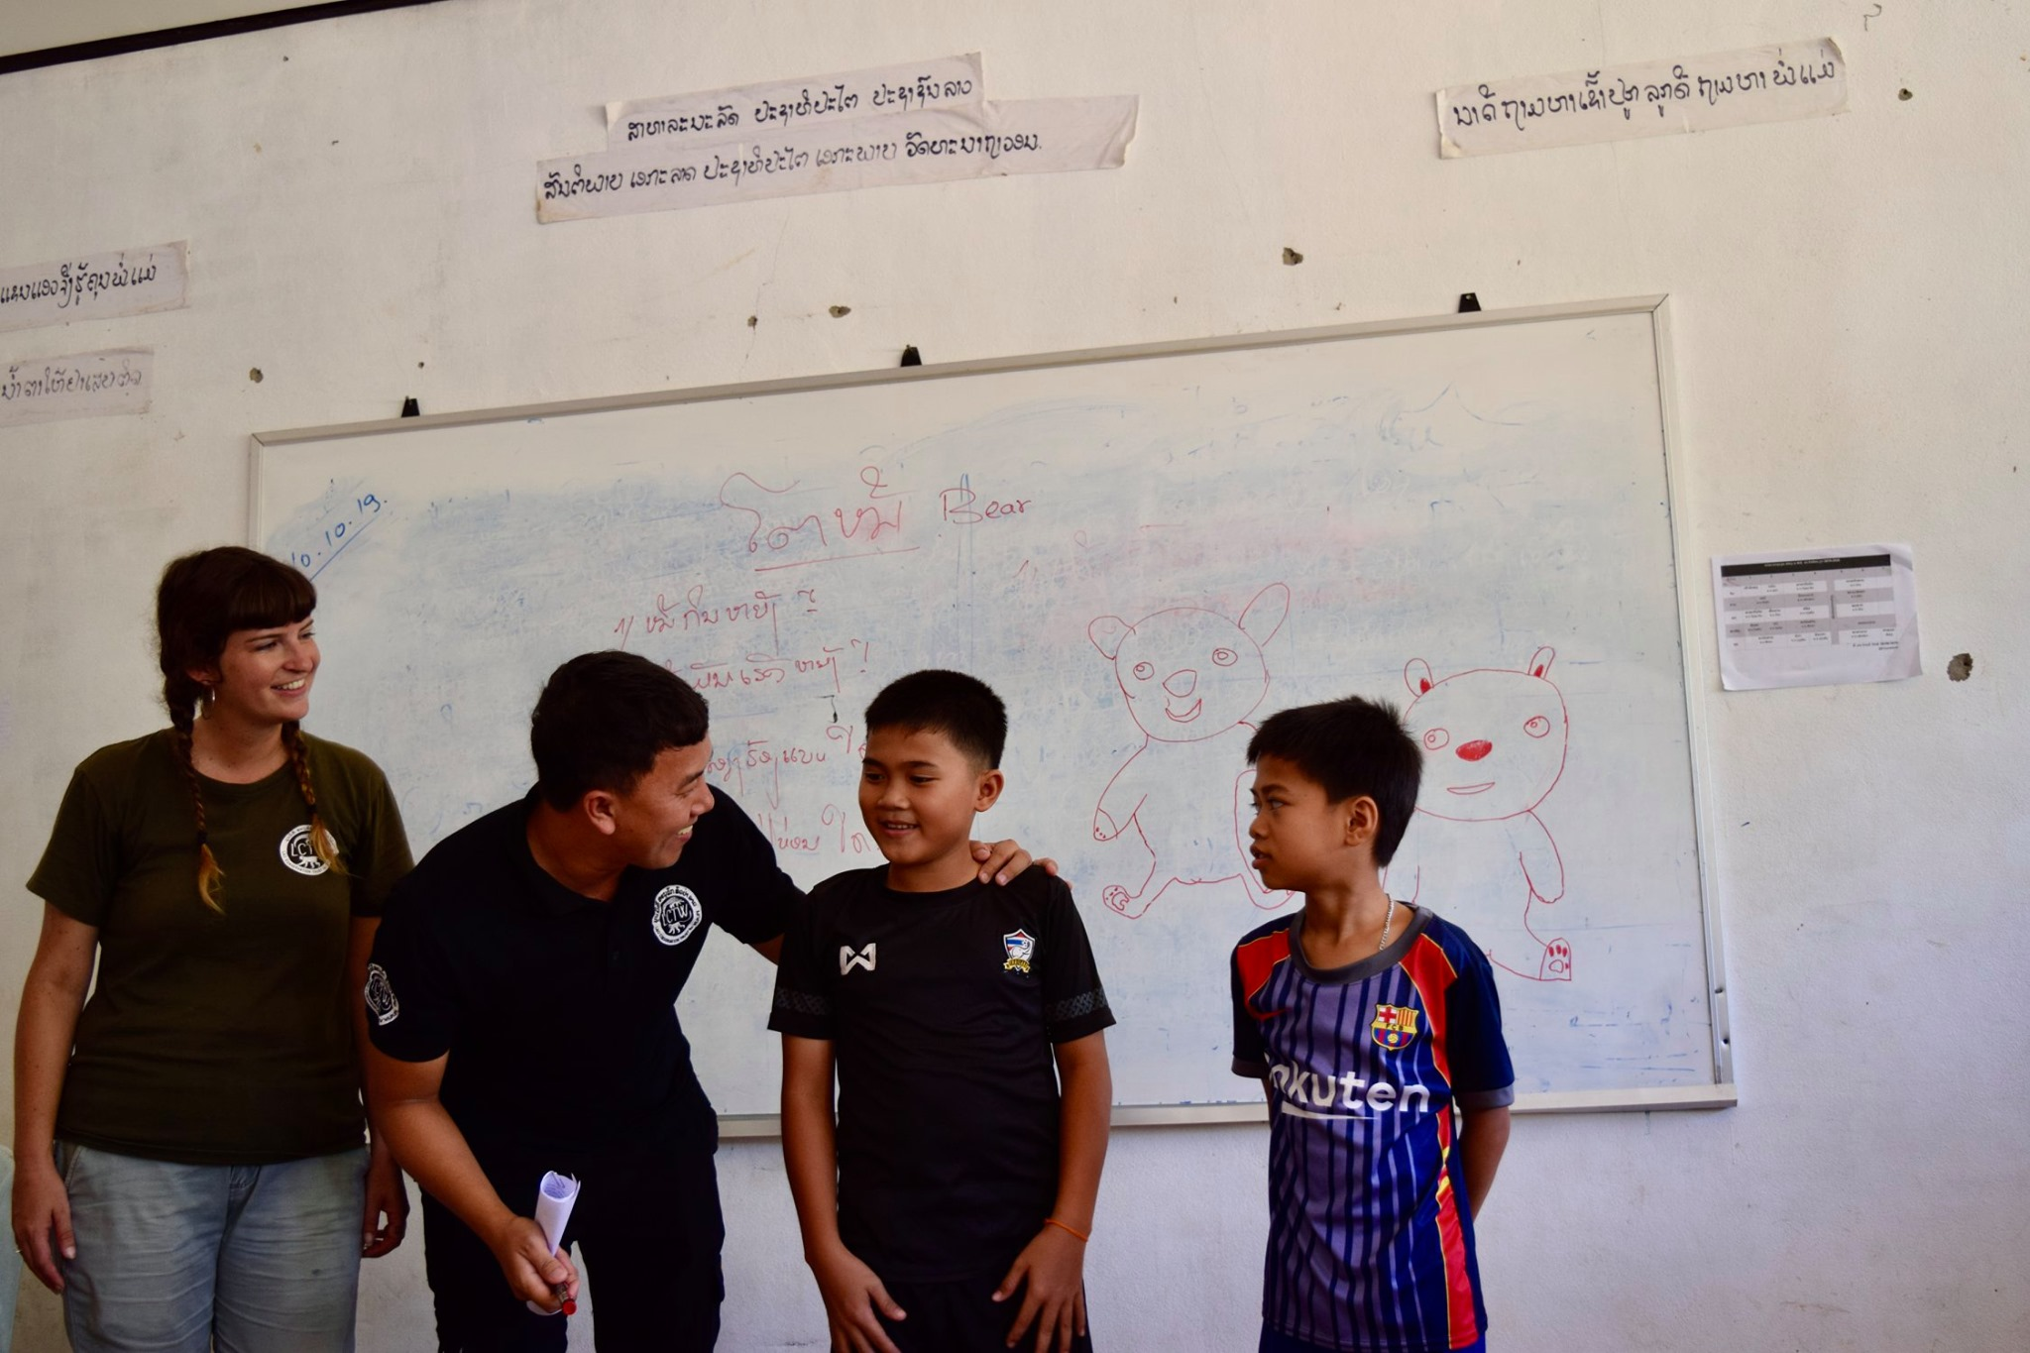
Education

Slide 12
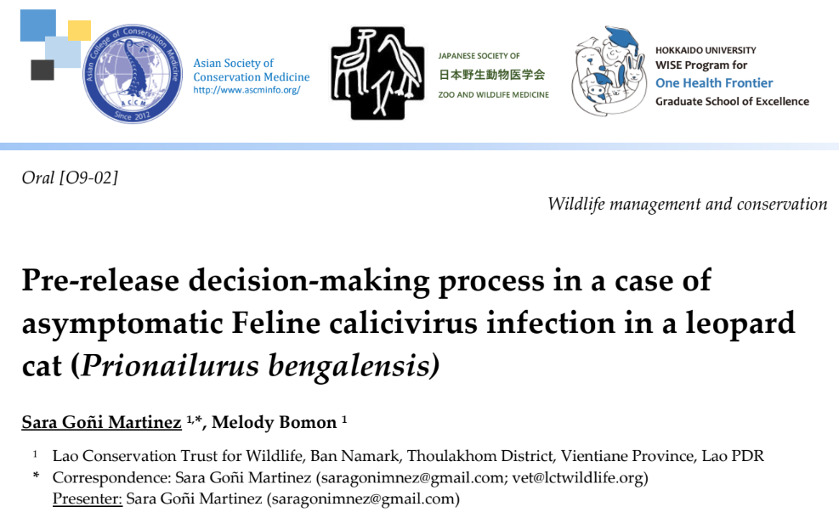
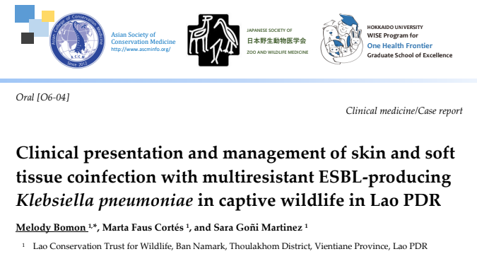
Research
Illegal wildlife trade data
Wildlife medicine - continuous learning, establishing reference ranges, etc. (ZIMS)
Disease surveillance (active and passive)
Collaboration with other organizations (e.g. IRD, WCS)
Visiting researchers

Slide 13
Role of wildlife rescue centers in One Health
WEAKNESSES
Research is not primary focus
Limited financial resources
Limited time
Lack of specialized research and laboratory knowledge
STRENGTHS
Animals
Samples
ACCESS

Slide 14
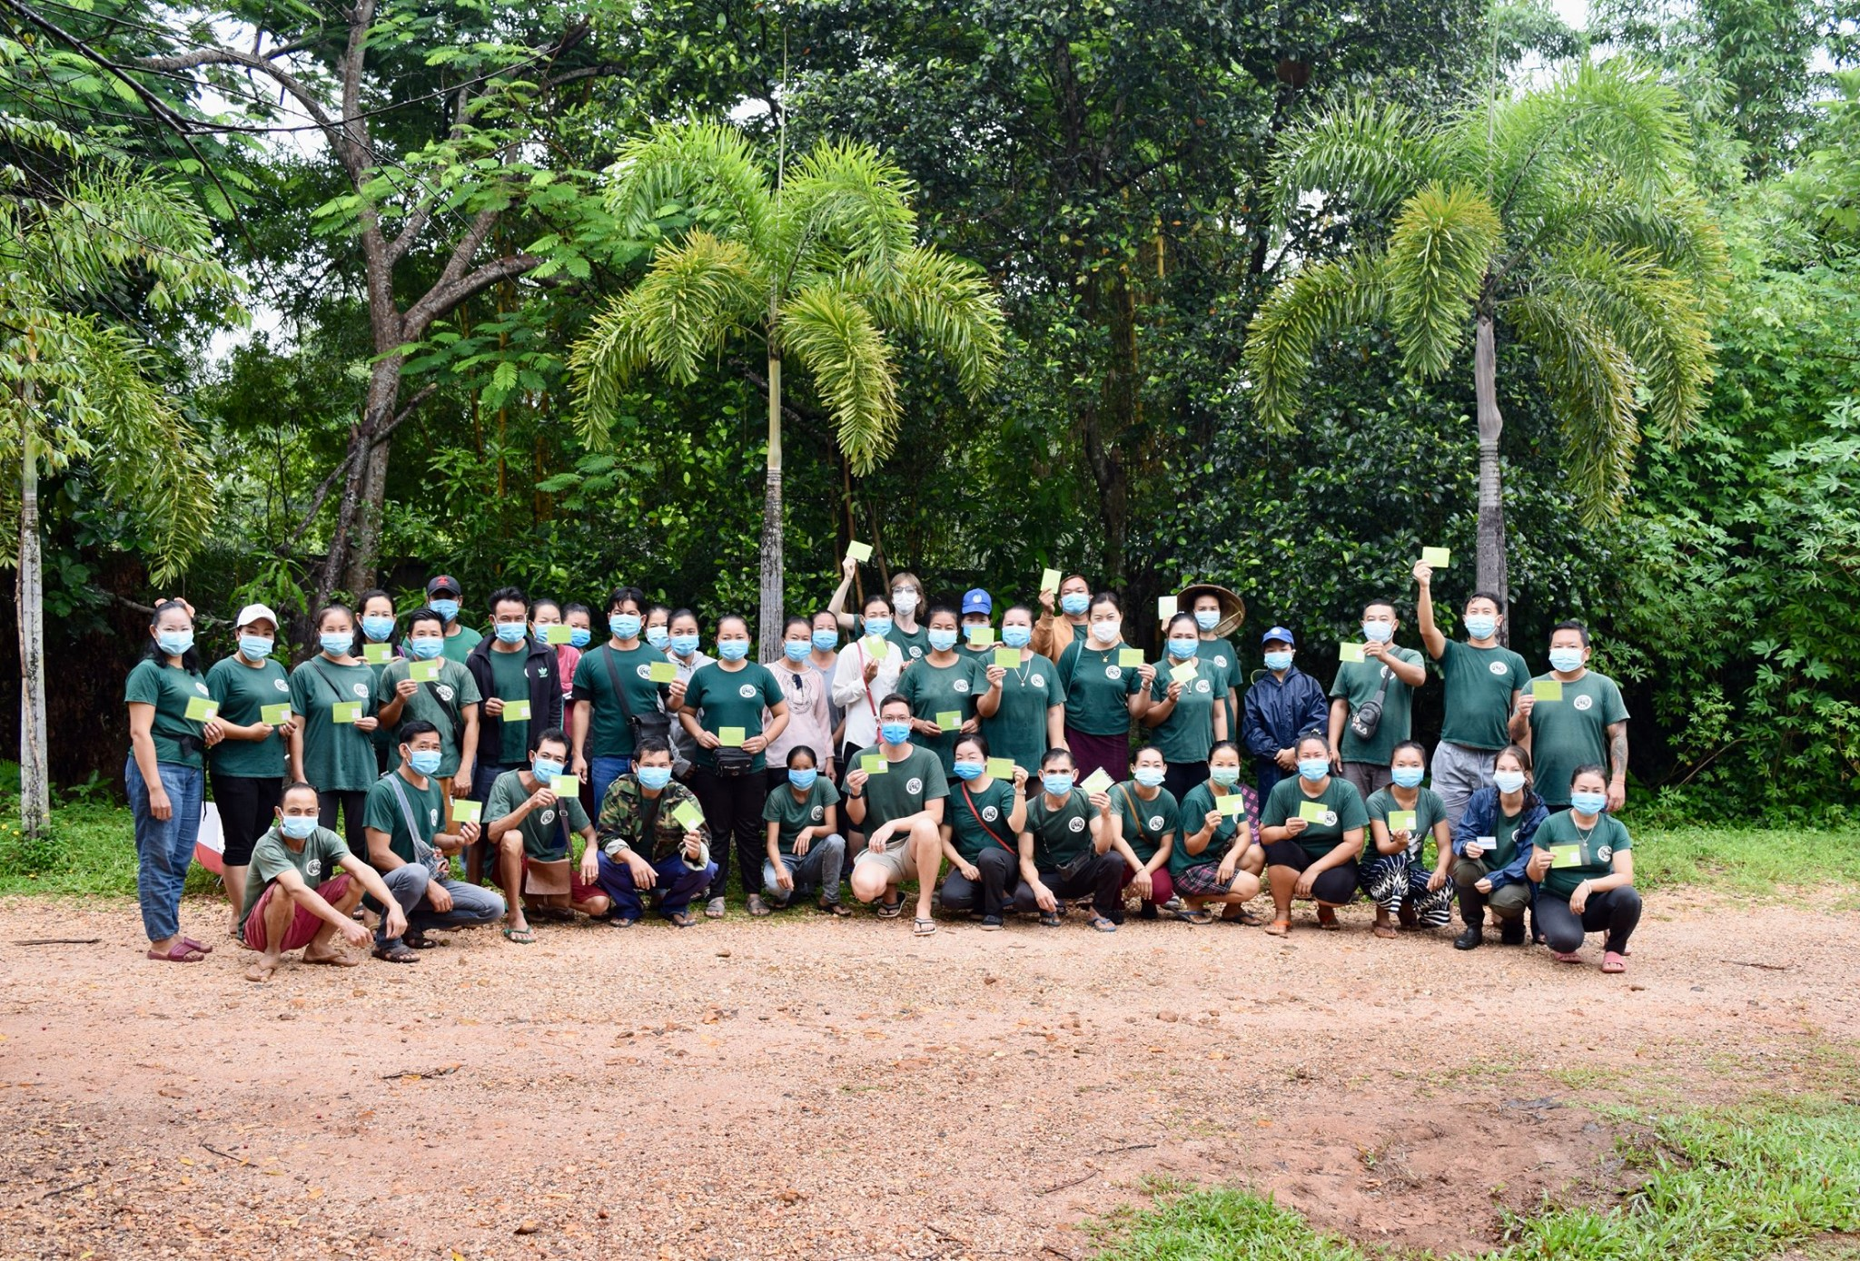
Human resources
Veterinary team: 2 veterinarians + 1 veterinary nurse
Biologists: 3
Animal keepers: ~20
Education team: 7
Support staff: ~20

Slide 15
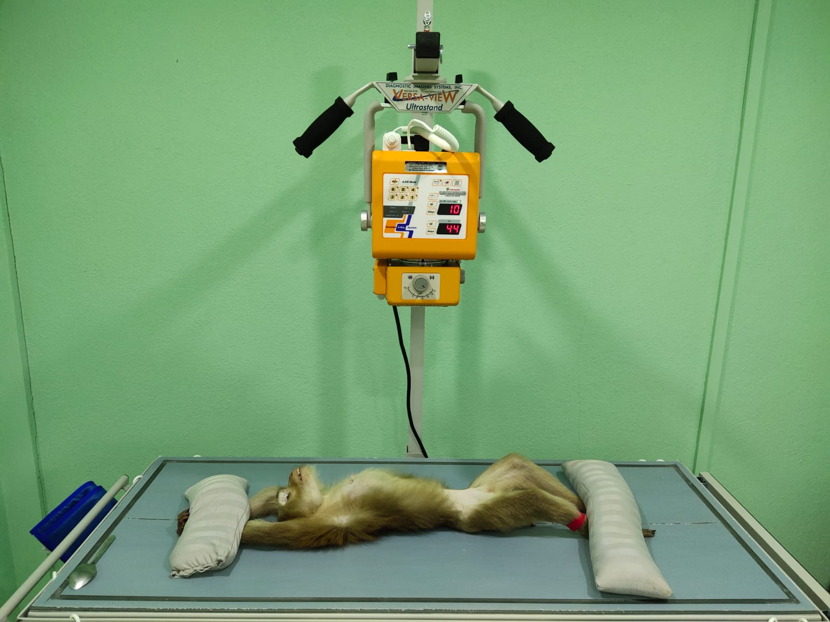
Facilities
Wildlife hospital:
x-ray, ultrasound
gas anesthesia
centrifuge
dry heat sterilizer
patient monitor
microscope
…
Animal enclosures
Quarantine - 28
Permanent enclosures - >100
Rehabilitation - 5
Relocating to protected area

Slide 16
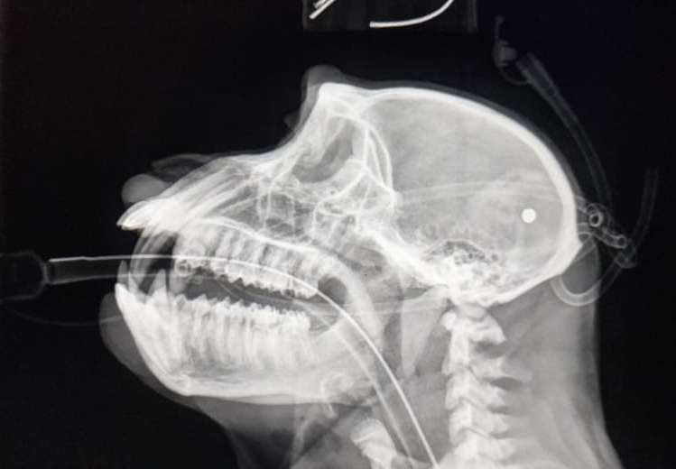
How would we like to improve?
Standardize disease monitoring
At admission
Pre-release
Increase diagnostic capacity
In house biochemistry and hematology
Histopathology
Increase disease testing capacity: TB, herpes B, gibbon hepatitis B virus, etc.
Genetic testing
Species and subspecies identification
Forensic database
Captive breeding programs
Post-release monitoring

Slide 17
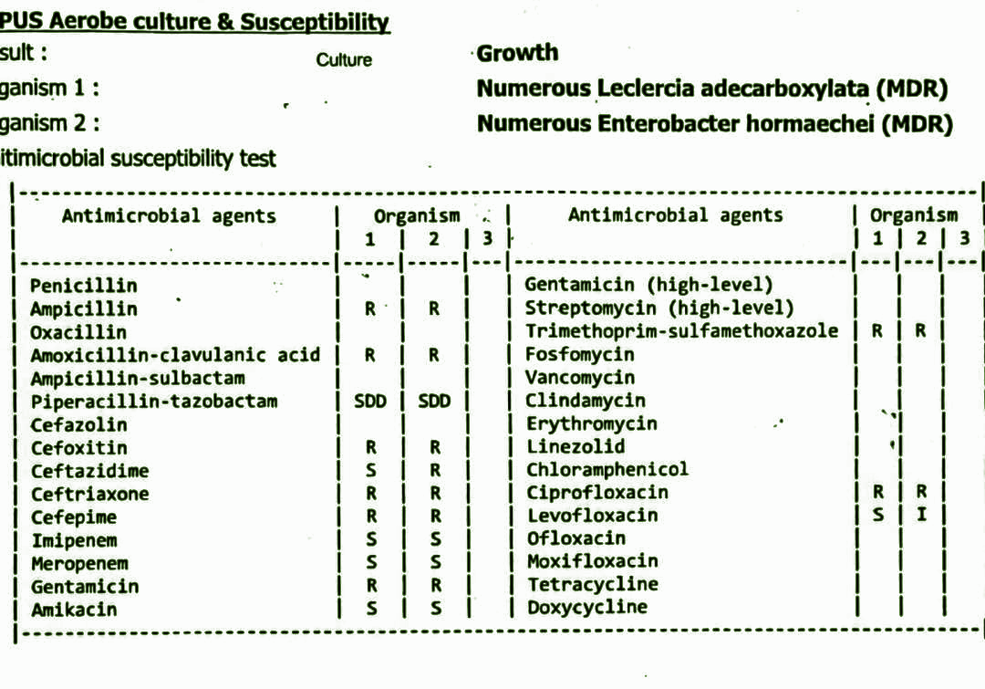
Knowledge gaps we would like to address?
What should we be testing for?
Wildlife = sentinel
Zoonotic diseases?
Antropozoonotic diseases?
MDR bacteria?
Impact of release
Post-release survival?
Impact on ecosystems?

Slide 18
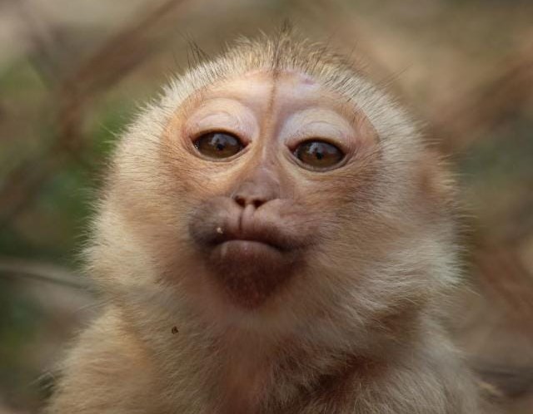
What is the most important/pressing question to address in a ONE-HEALTH research proposal ?
Responsible rescue, rehab and release of macaques.
Why?
Most rescued species
Rescue centers are over capacity
High risk of disease transmission
Very difficult to rehabilitate
Release is difficult and risky
Euthanasia is controversial

